Slide 1
Global Prevalence and Burden of Mental Health Disorders
Exploratory Data Analysis (EDA)
Luna Pérez Troncoso

Slide 2
INDEX
Introduction
01
04
Metrics and Classifications
Objectives
02
05
Results
Data information
03
06
Conclusions

Slide 3
INDEX
Introduction
01
04
Metrics and Classifications
Objectives
02
05
Results
Data information
03
06
Conclusions

Slide 4
INDEX
Introduction
01
04
Metrics and Classifications
Objectives
02
05
Results
Data information
03
06
Conclusions

Slide 5
INDEX
Introduction
01
04
Metrics and Classifications
Objectives
02
05
Results
Data information
03
06
Conclusions

Slide 6
INDEX
Introduction
01
04
Metrics and Classifications
Objectives
02
05
Results
Data information
03
06
Conclusions

Slide 7
INDEX
Introduction
01
04
Metrics and Classifications
Objectives
02
05
Results
Data information
03
06
Conclusions

Slide 8
INTRODUCTION
Mental health plays a fundamental role in the overall well-being of individuals and the stability of societies

Slide 9
INTRODUCTION
Mental health plays a fundamental role in the overall well-being of individuals and the stability of societies
When mental health deteriorates, the consequences extend beyond the individual, affecting families, workplaces, and communities at large

Slide 10
INTRODUCTION
Mental health plays a fundamental role in the overall well-being of individuals and the stability of societies
When mental health deteriorates, the consequences extend beyond the individual, affecting families, workplaces, and communities at large
Mental health disorders represent a growing public health concern.

Slide 11


INTRODUCTION
Mental health plays a fundamental role in the overall well-being of individuals and the stability of societies
When mental health deteriorates, the consequences extend beyond the individual, affecting families, workplaces, and communities at large
Mental health disorders represent a growing public health concern.

Slide 12
INTRODUCTION
Mental health plays a fundamental role in the overall well-being of individuals and the stability of societies
When mental health deteriorates, the consequences extend beyond the individual, affecting families, workplaces, and communities at large
Mental health disorders represent a growing public health concern.

Slide 13
INTRODUCTION
Mental health plays a fundamental role in the overall well-being of individuals and the stability of societies
When mental health deteriorates, the consequences extend beyond the individual, affecting families, workplaces, and communities at large
Mental health disorders represent a growing public health concern.
One in three women and one in five men will experience a major depressive episode at some point in their lives.

Slide 14
OBJECTIVES
This exploratory data analysis (EDA) aims to investigate the global prevalence and burden of mental health disorders across countries, continents, and socioeconomic regions.

Slide 15
OBJECTIVES
This exploratory data analysis (EDA) aims to investigate the global prevalence and burden of mental health disorders across countries, continents, and socioeconomic regions.
By identifying global trends and potential contributing factors, this analysis seeks to provide a clearer understanding of how mental health challenges manifest across different populations and what patterns may inform prevention and intervention strategies

Slide 16
DATA INFORMATION

Slide 17
DATA INFORMATION
Data Sources
100
75
50
25

Slide 18
DATA INFORMATION
Data Sources
Data comes from a kaggle dataset shared by Mohamadreza Momeni. This data was collected through OurWorldInData platform from Global Burden of Disease study by Institute for Health Metrics and Evaluation (GBD-IHME) from the University of Washington and World Health Organization (WHO)
100
75
50
25

Slide 19

DATA INFORMATION
Data Sources
Data comes from a kaggle dataset shared by Mohamadreza Momeni. This data was collected through OurWorldInData platform from Global Burden of Disease study by Institute for Health Metrics and Evaluation (GBD-IHME) from the University of Washington and World Health Organization (WHO)
100
75
50
25

Slide 20

DATA INFORMATION
Data Sources
Data comes from a kaggle dataset shared by Mohamadreza Momeni. This data was collected through OurWorldInData platform from Global Burden of Disease study by Institute for Health Metrics and Evaluation (GBD-IHME) from the University of Washington and World Health Organization (WHO)
100
75
50
25

Slide 21


DATA INFORMATION
Data Sources
Data comes from a kaggle dataset shared by Mohamadreza Momeni. This data was collected through OurWorldInData platform from Global Burden of Disease study by Institute for Health Metrics and Evaluation (GBD-IHME) from the University of Washington and World Health Organization (WHO)
100
75
50
25

Slide 22
DATA INFORMATION
Data Sources
Data comes from a kaggle dataset shared by Mohamadreza Momeni. This data was collected through OurWorldInData platform from Global Burden of Disease study by Institute for Health Metrics and Evaluation (GBD-IHME) from the University of Washington and World Health Organization (WHO)
100
75
50
25

Slide 23
DATA INFORMATION
Data Sources
Data comes from a kaggle dataset shared by Mohamadreza Momeni. This data was collected through OurWorldInData platform from Global Burden of Disease study by Institute for Health Metrics and Evaluation (GBD-IHME) from the University of Washington and World Health Organization (WHO)
100
Classification Criteria
75
50
25

Slide 24

DATA INFORMATION
Data Sources
Data comes from a kaggle dataset shared by Mohamadreza Momeni. This data was collected through OurWorldInData platform from Global Burden of Disease study by Institute for Health Metrics and Evaluation (GBD-IHME) from the University of Washington and World Health Organization (WHO)
100
Classification Criteria
Geographic regions were divided using World Health Organization (WHO) criteria, whereas economic classification of the countries by level of income followed the criteria established by World Bank (WB)
75
50
25

Slide 25
DATA INFORMATION
Data Sources
Data comes from a kaggle dataset shared by Mohamadreza Momeni. This data was collected through OurWorldInData platform from Global Burden of Disease study by Institute for Health Metrics and Evaluation (GBD-IHME) from the University of Washington and World Health Organization (WHO)
100
Classification Criteria
Geographic regions were divided using World Health Organization (WHO) criteria, whereas economic classification of the countries by level of income followed the criteria established by World Bank (WB)
75
50
25

Slide 26
DATA INFORMATION
Data Sources
Data comes from a kaggle dataset shared by Mohamadreza Momeni. This data was collected through OurWorldInData platform from Global Burden of Disease study by Institute for Health Metrics and Evaluation (GBD-IHME) from the University of Washington and World Health Organization (WHO)
100
Classification Criteria
Geographic regions were divided using World Health Organization (WHO) criteria, whereas economic classification of the countries by level of income followed the criteria established by World Bank (WB)
75
50
Health Metrics
25

Slide 27
DATA INFORMATION
Data Sources
Data comes from a kaggle dataset shared by Mohamadreza Momeni. This data was collected through OurWorldInData platform from Global Burden of Disease study by Institute for Health Metrics and Evaluation (GBD-IHME) from the University of Washington and World Health Organization (WHO)
100
Classification Criteria
Geographic regions were divided using World Health Organization (WHO) criteria, whereas economic classification of the countries by level of income followed the criteria established by World Bank (WB)
75
50
Health Metrics
25
Prevalence data is expressed in percentages of prevalence, whereas burden is measured by Disability-Adjusted Life Years (DALYs) rate per 100.000 Population.

Slide 28
¿What are the geographic regions of the WHO?

Slide 29
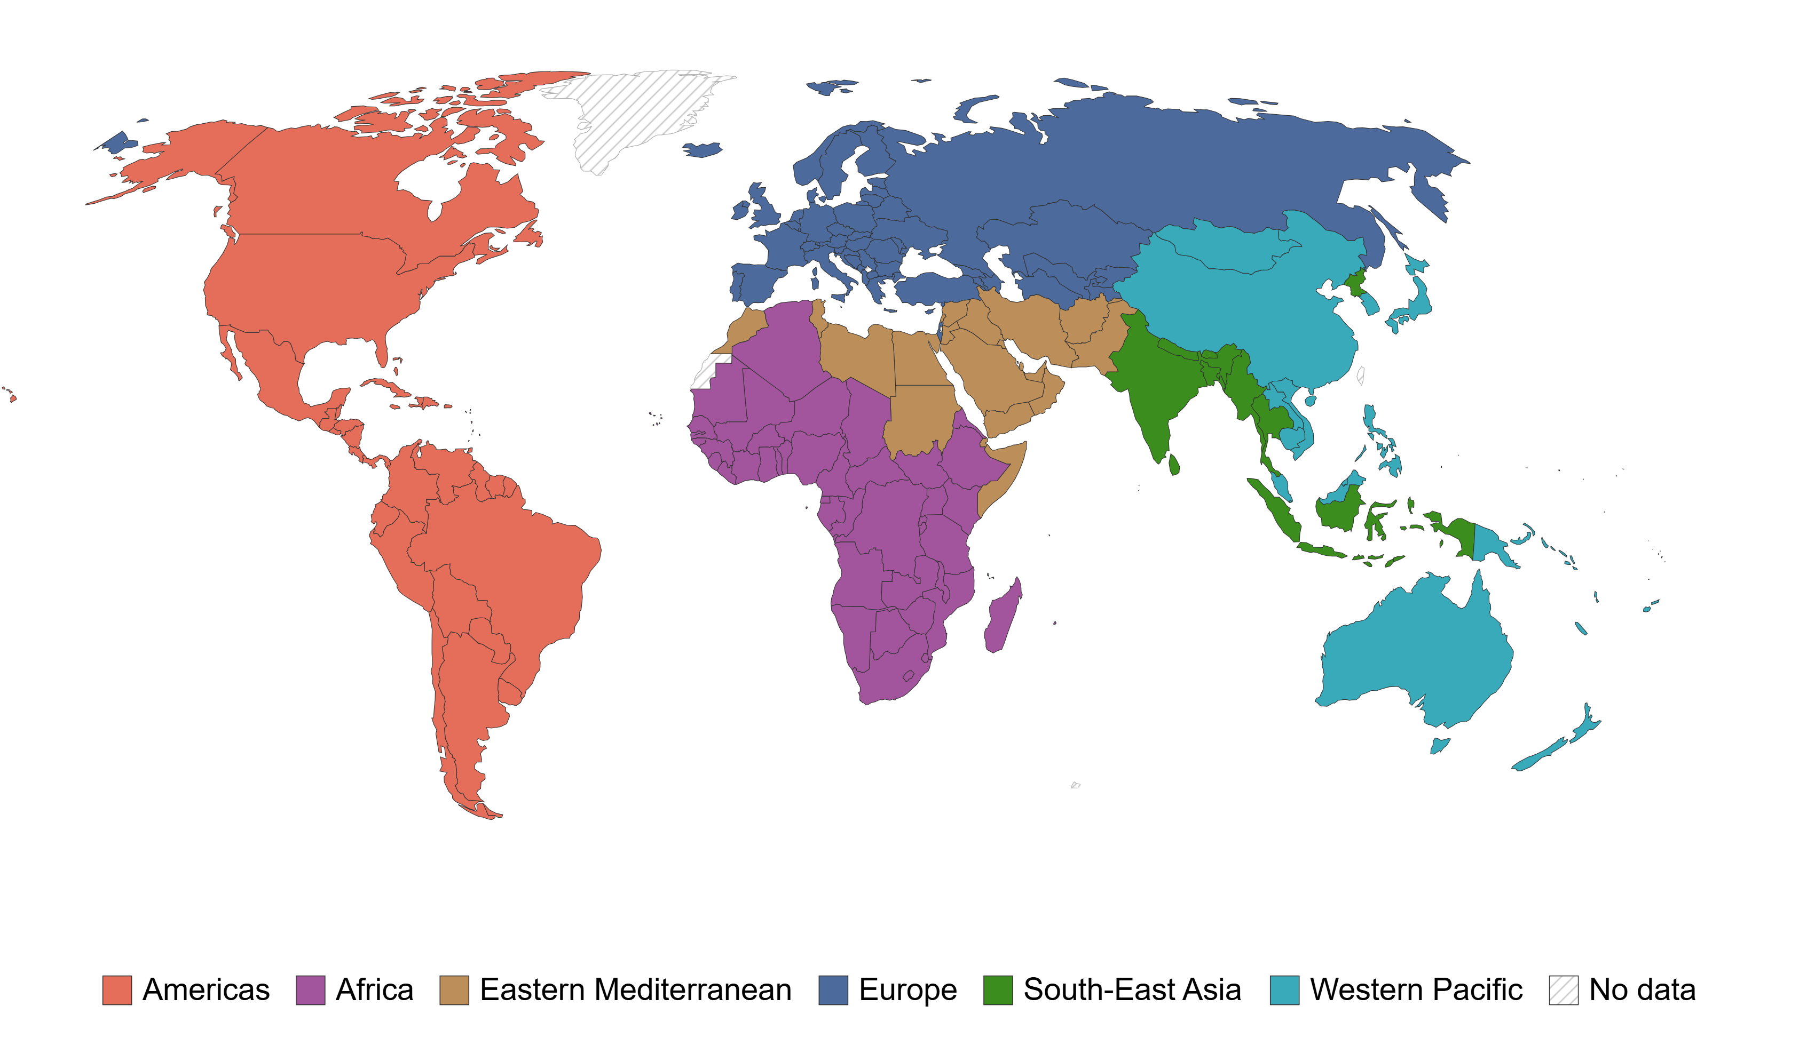
¿What are the geographic regions of the WHO?

Slide 30
¿What is the economic classificacion of the WB?

Slide 31
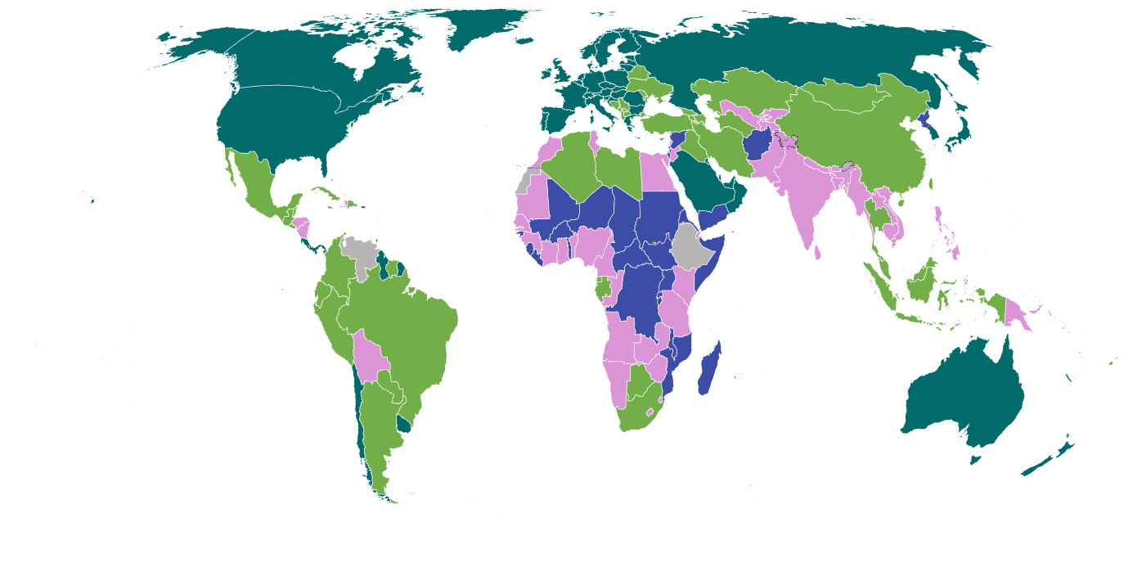
¿What is the economic classificacion of the WB?

Slide 32
¿What is the DALYs rate?

Slide 33
¿What is the DALYs rate?
Disability-adjusted life years (DALYs) represent the sum of years lost to premature death and years lived with disability.

Slide 34
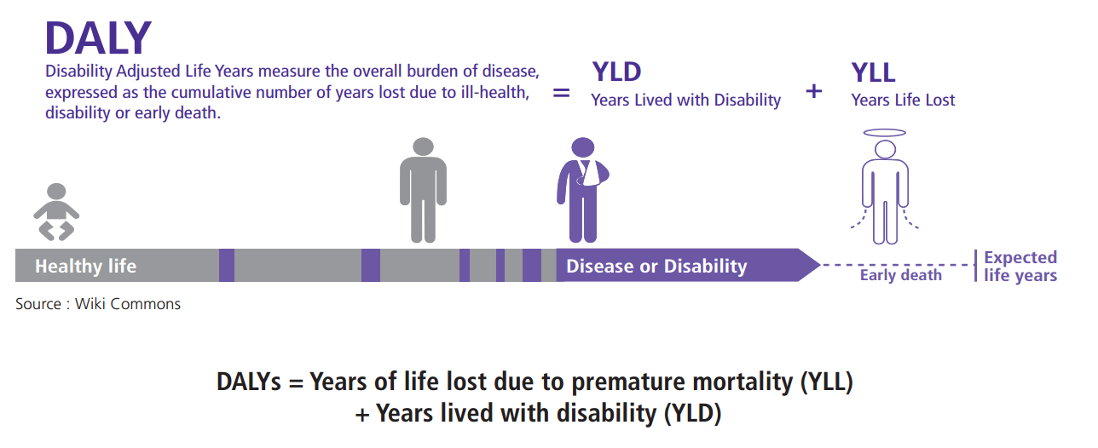
¿What is the DALYs rate?
Disability-adjusted life years (DALYs) represent the sum of years lost to premature death and years lived with disability.

Slide 35
RESULTS

Slide 36
Global mental health disorders prevalence and burden analysis

Slide 37
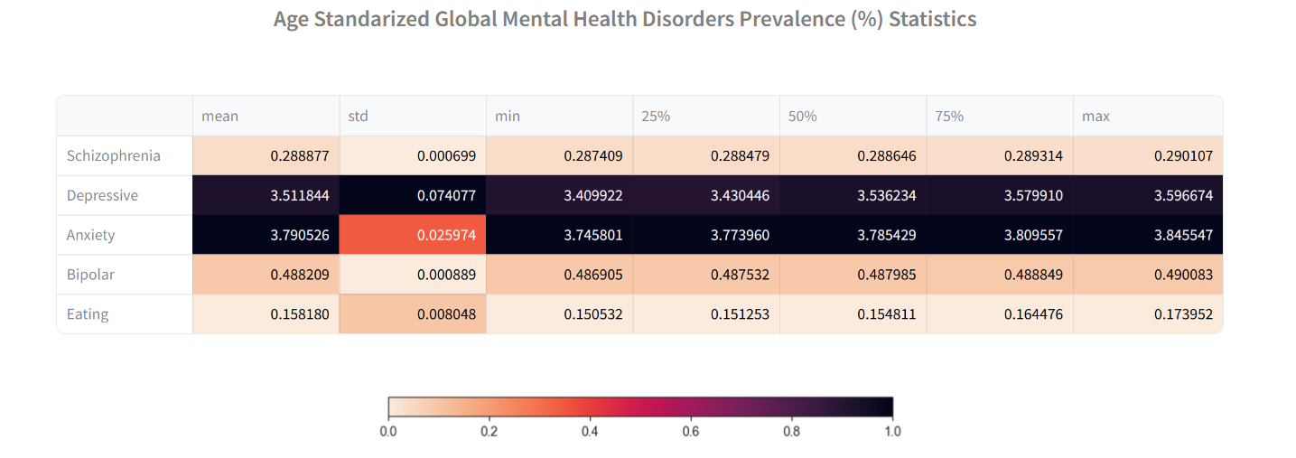
Global mental health disorders prevalence and burden analysis

Slide 38
Global mental health disorders prevalence and burden analysis

Slide 39
Global mental health disorders prevalence and burden analysis

Slide 40
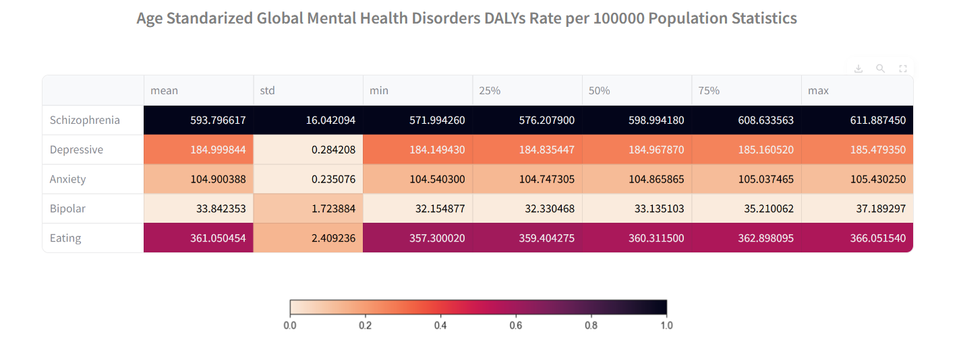
Global mental health disorders prevalence and burden analysis

Slide 41
Cross-country mental health disorders metrics

Slide 42
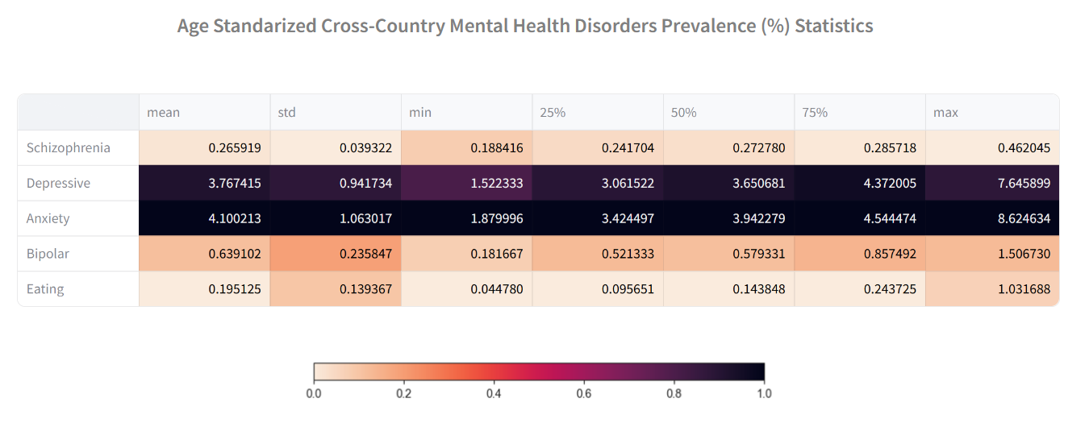
Cross-country mental health disorders metrics

Slide 43
Cross-country mental health disorders metrics

Slide 44
Cross-country mental health disorders metrics

Slide 45
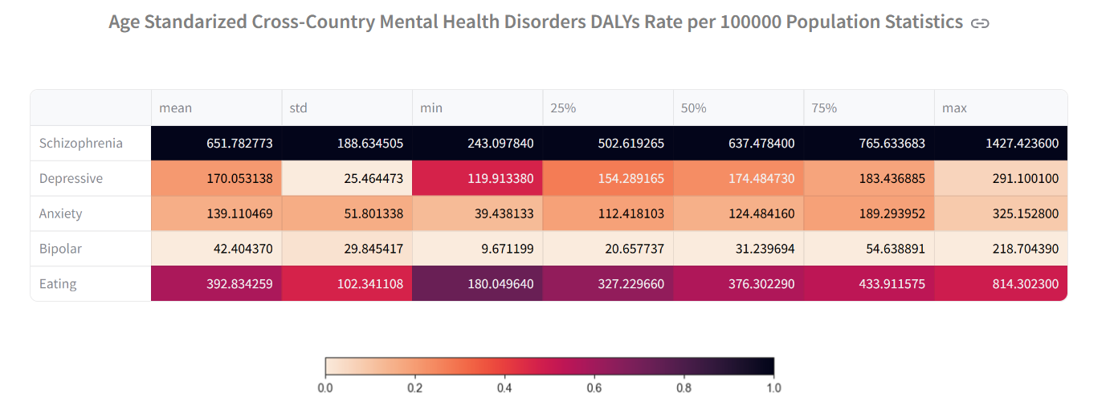
Cross-country mental health disorders metrics

Slide 46
Cross-country mental health disorders metrics distribution

Slide 47
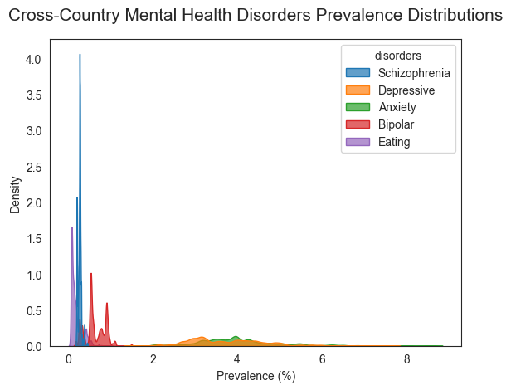
Cross-country mental health disorders metrics distribution

Slide 48
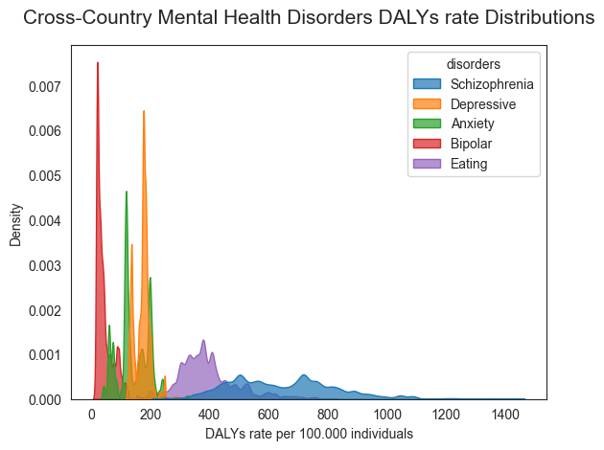
Cross-country mental health disorders metrics distribution

Slide 49
Cross-country progression mental health disorders

Slide 50
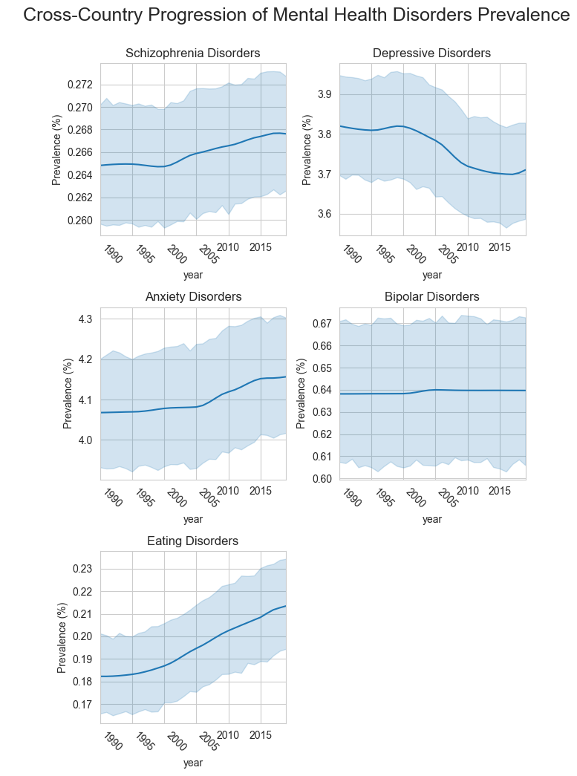
Cross-country progression mental health disorders

Slide 51
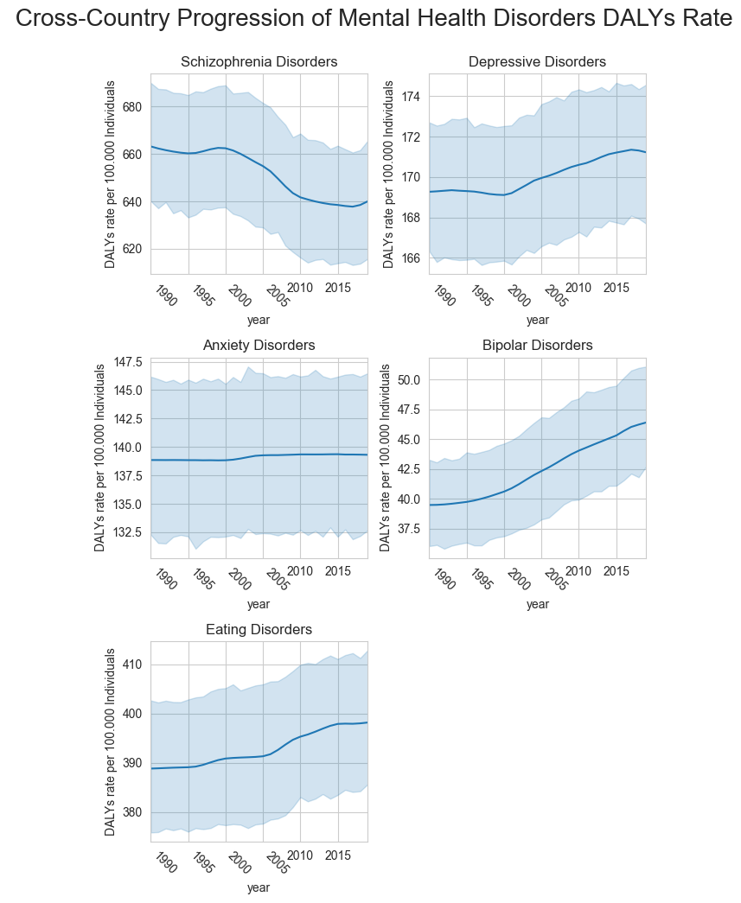
Cross-country progression mental health disorders

Slide 52
Cross-country progression mental health disorders
****
****
****
****
****
*
****
***
****
****
* p-values < 0.05
*** p-values < 0.001
**** p-values < 0.0001

Slide 53
Cross-country progression mental health disorders
****
****
****
****
****
*
****
***
****
****
* p-values < 0.05
*** p-values < 0.001
**** p-values < 0.0001

Slide 54
Cross-country progression mental health disorders
****
****
****
****
****
****
*
****
***
****
****
* p-values < 0.05
*** p-values < 0.001
**** p-values < 0.0001
↑17%

Slide 55
Cross-country progression mental health disorders
****
****
****
****
****
****
*
****
***
****
****
↑17%
* p-values < 0.05
*** p-values < 0.001
**** p-values < 0.0001
↑13%

Slide 56
Progression of mental health disorders by geographic region

Slide 57
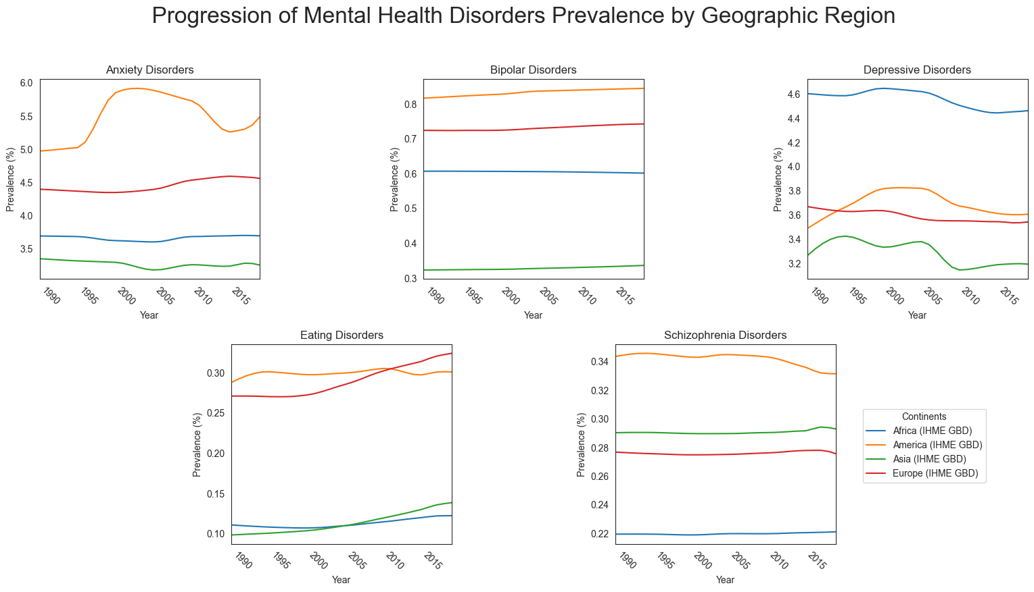
Progression of mental health disorders by geographic region

Slide 58
Progression of mental health disorders by geographic region

Slide 59
Progression of mental health disorders by geographic region

Slide 60
Progression of mental health disorders by geographic region

Slide 61
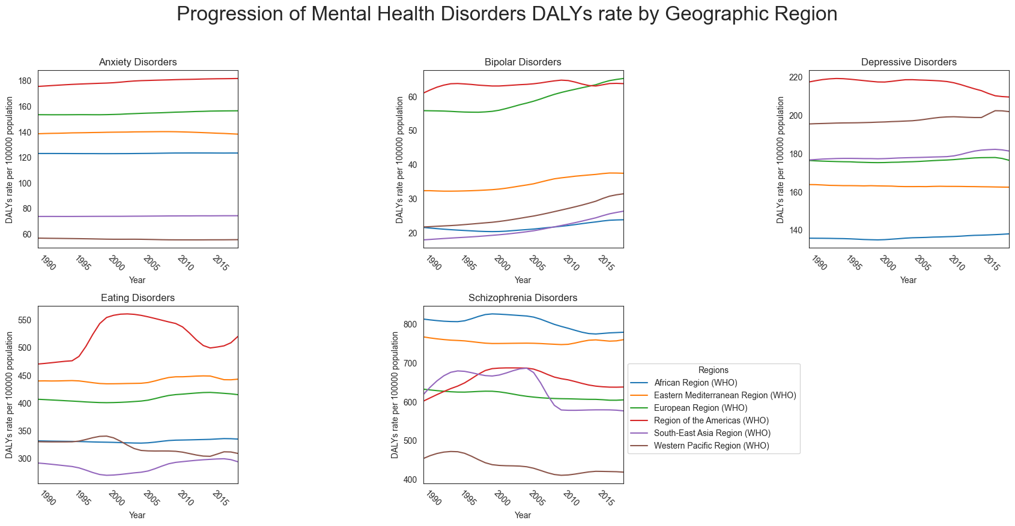

Progression of mental health disorders by geographic region

Slide 62
Progression of mental health disorders by geographic region

Slide 63
Progression of mental health disorders by geographic region

Slide 64
Mental health disorders by geographic region

Slide 65
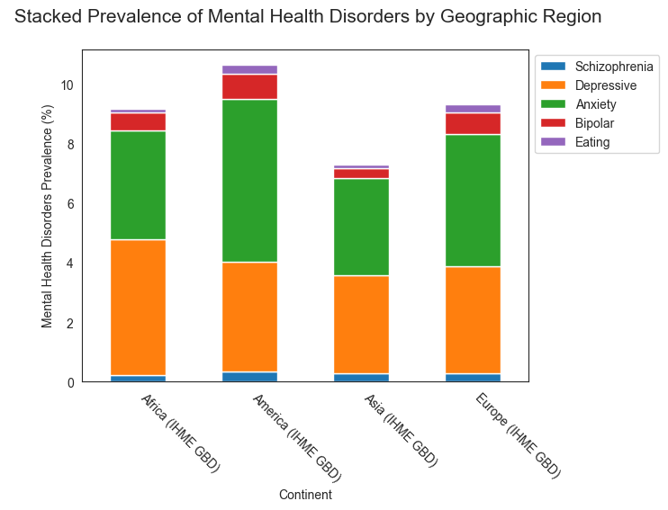
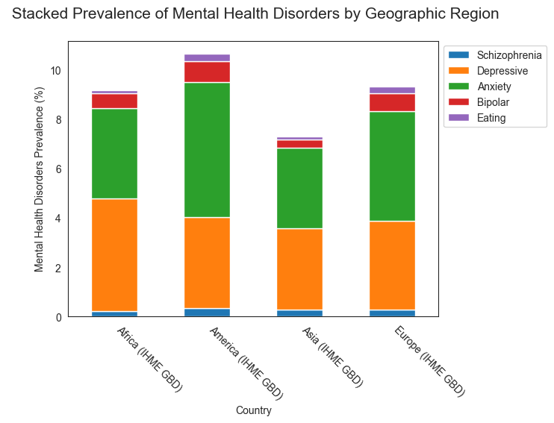
Mental health disorders by geographic region

Slide 66
Mental health disorders by geographic region
****
****
****
****
**** p-values < 0.0001

Slide 67
Mental health disorders by geographic region
****
****
****
****
**** p-values < 0.0001
p-values < 10^(-20) !

Slide 68
Mental health disorders by geographic region
****
↑29%
****
****
****
**** p-values < 0.0001

Slide 69
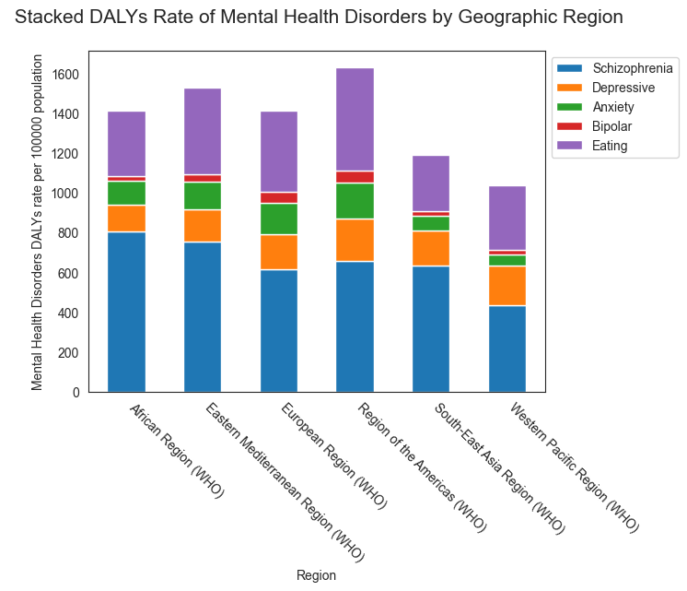
Mental health disorders by geographic region

Slide 70
Mental health disorders by geographic region
↑27%

Slide 71
Progression of mental health disorders by Income Level

Slide 72
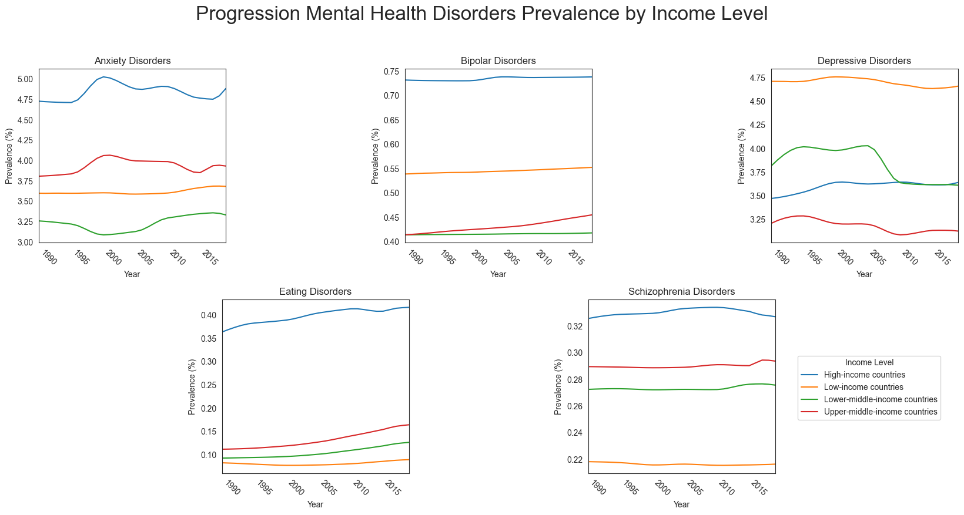
Progression of mental health disorders by Income Level

Slide 73
Progression of mental health disorders by Income Level

Slide 74
Progression of mental health disorders by Income Level

Slide 75
Progression of mental health disorders by Income Level

Slide 76
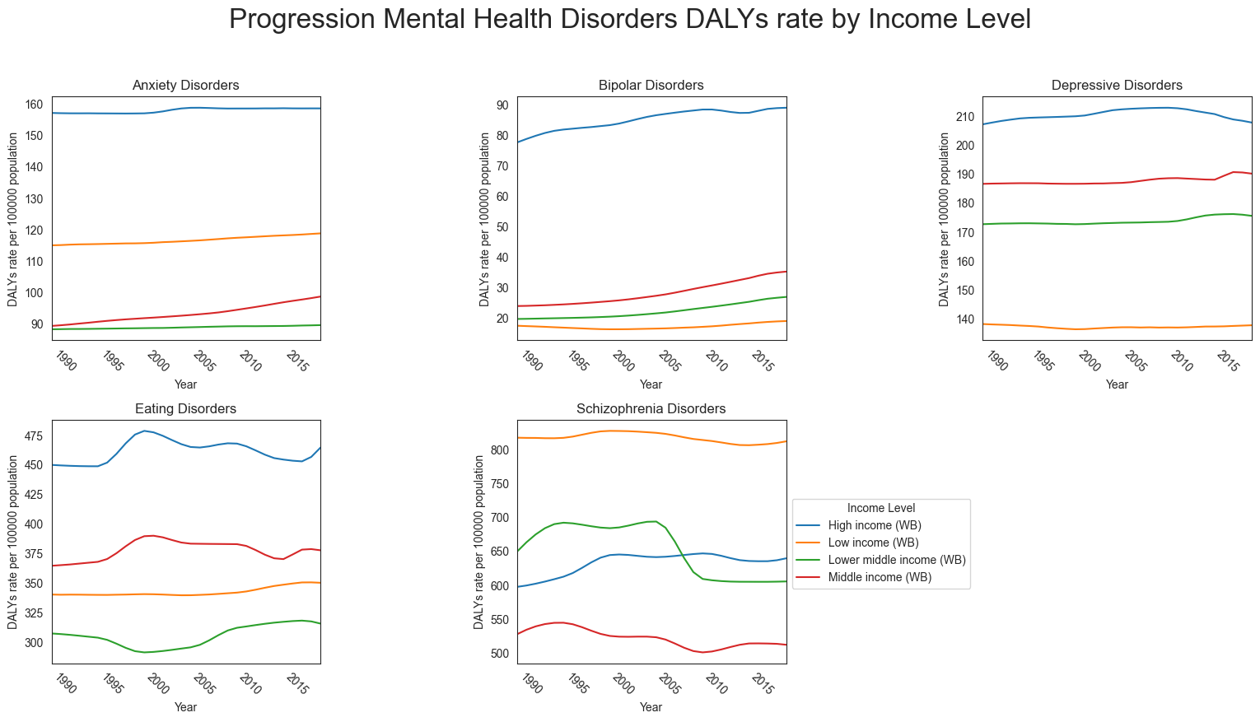
Progression of mental health disorders by Income Level

Slide 77
Progression of mental health disorders by Income Level

Slide 78
Progression of mental health disorders by Income Level

Slide 79
Mental health disorders by Income Level

Slide 80
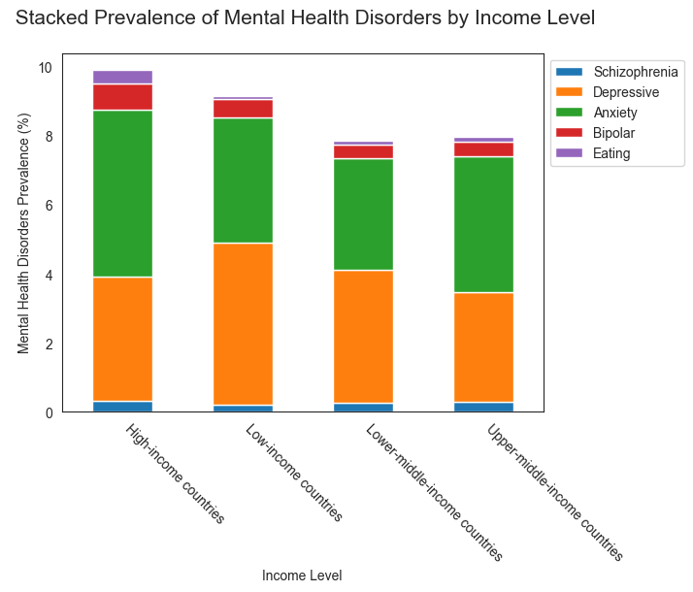
Mental health disorders by Income Level

Slide 81
Mental health disorders by Income Level
****
****
****
****
**** p-values < 0.0001

Slide 82
Mental health disorders by Income Level
****
****
****
****
**** p-values < 0.0001
p-values < 10^(-10) !

Slide 83
Mental health disorders by Income Level
****
↑20%
****
****
****
**** p-values < 0.0001

Slide 84
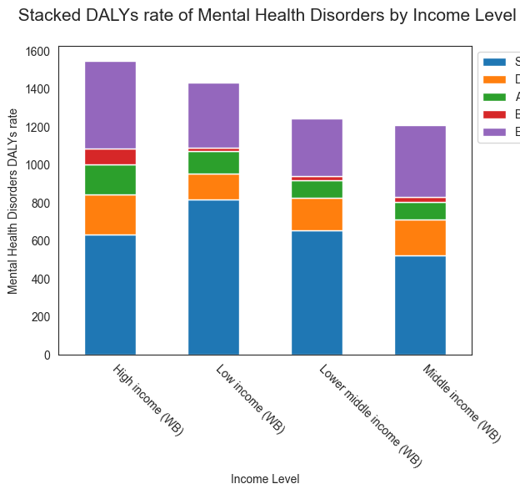
Mental health disorders by Income Level
****
****
****
****
**** p-values < 0.0001

Slide 85
Mental health disorders by Income Level
****
****
****
****
****
****
****
****
**** p-values < 0.0001

Slide 86
Mental health disorders by Income Level
****
****
↑21%
****
****
****
****
****
****
**** p-values < 0.0001

Slide 87
Mental health disorders prevalence and burden analysis by country

Slide 88
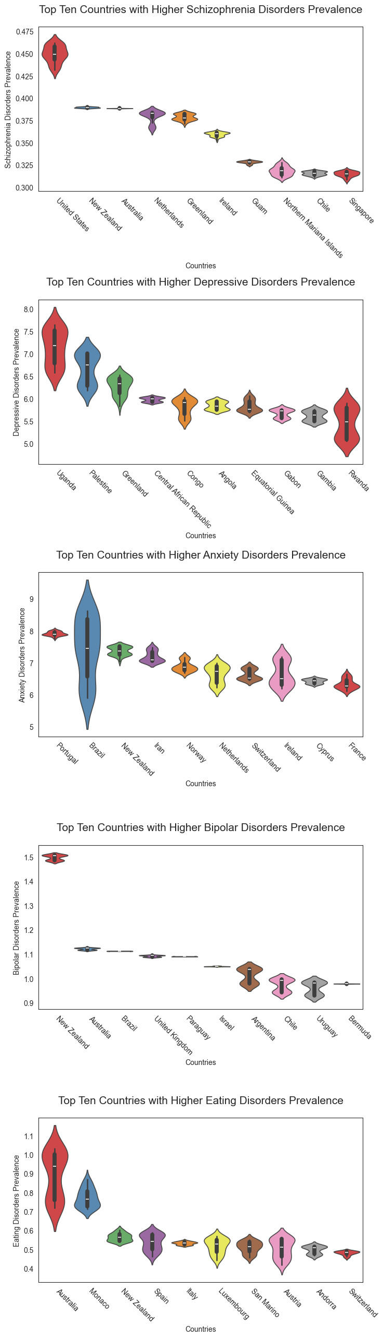
Mental health disorders prevalence and burden analysis by country

Slide 89
Mental health disorders prevalence and burden analysis by country
All of the p-values < 10^(-40) !

Slide 90
Mental health disorders prevalence and burden analysis by country

Slide 91

Mental health disorders prevalence and burden analysis by country
↑55%

Slide 92



Mental health disorders prevalence and burden analysis by country
↑100-80%

Slide 93



Mental health disorders prevalence and burden analysis by country
↑108-94%

Slide 94
Mental health disorders prevalence and burden analysis by country
↑208%

Slide 95


Mental health disorders prevalence and burden analysis by country
↑506-394%

Slide 96
Mental health disorders prevalence and burden analysis by country

Slide 97
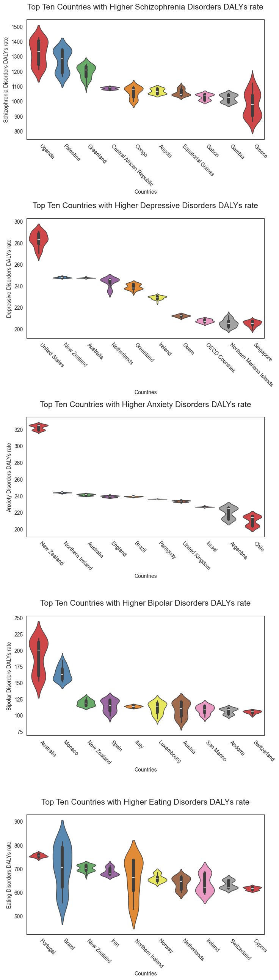
Mental health disorders prevalence and burden analysis by country
All of the p-values < 10^(-20) !

Slide 98
Mental health disorders prevalence and burden analysis by country
↑122-101%

Slide 99
Mental health disorders prevalence and burden analysis by country
↑53%

Slide 100
Mental health disorders prevalence and burden analysis by country
↑209%

Slide 101
Mental health disorders prevalence and burden analysis by country
↑500-391%

Slide 102
Mental health disorders prevalence and burden analysis by country
↑109-95%

Slide 103
Mental health disorders prevalence and burden analysis by country

Slide 104
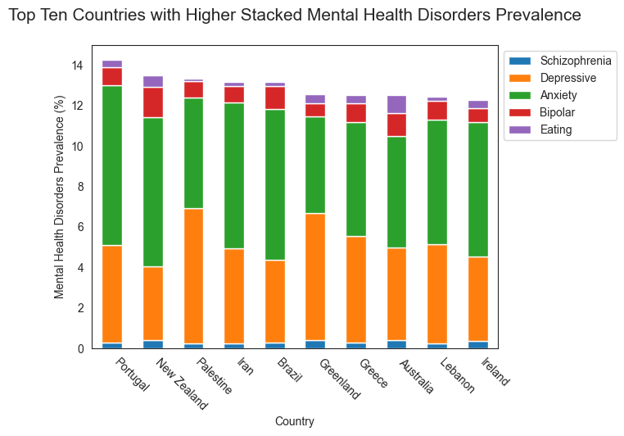
Mental health disorders prevalence and burden analysis by country
↑73-48%
All of the p-values < 10^(-40) !

Slide 105
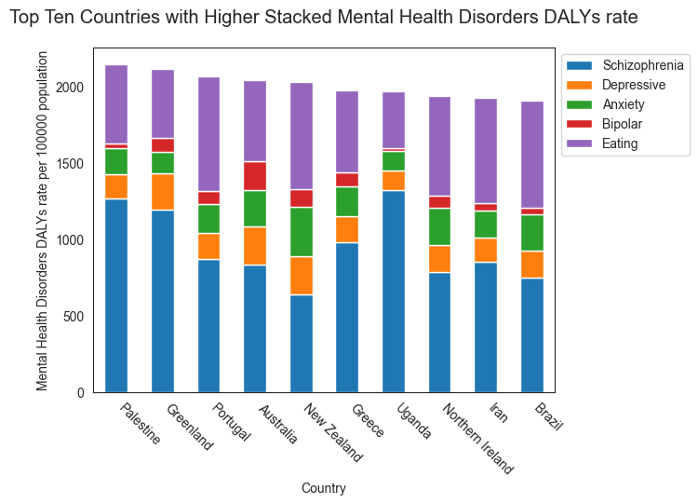
Mental health disorders prevalence and burden analysis by country
↑73-48%
↑69-49%
All of the p-values < 10^(-40) !

Slide 106
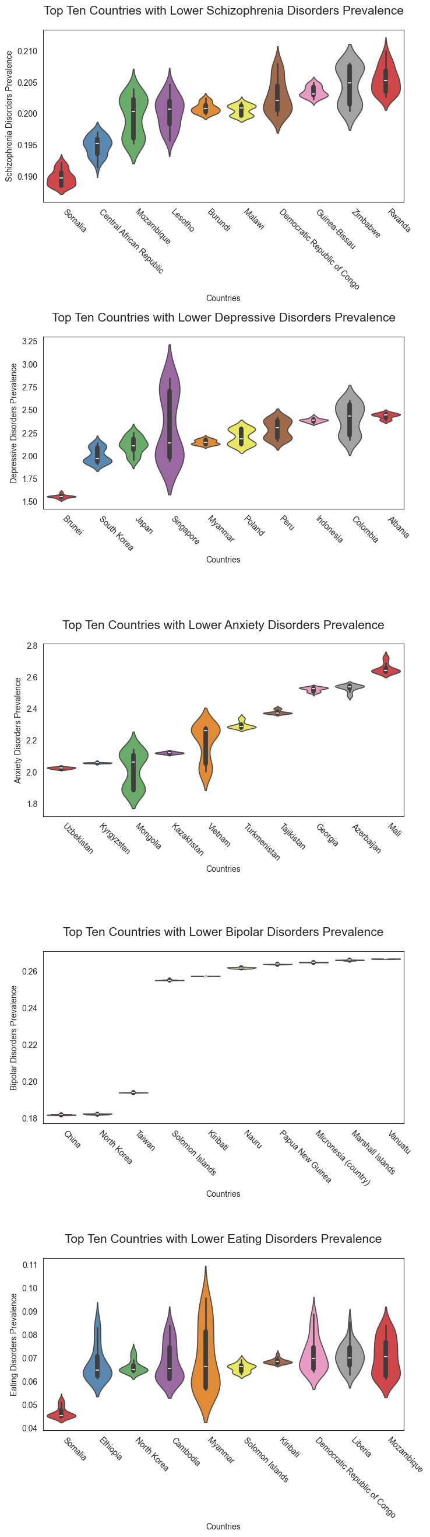
Mental health disorders prevalence and burden analysis by country
All of the p-values < 10^(-38) !

Slide 107


Mental health disorders prevalence and burden analysis by country
↓37-35%

Slide 108

Mental health disorders prevalence and burden analysis by country
↓56%

Slide 109



Mental health disorders prevalence and burden analysis by country
↓47-46%

Slide 110



Mental health disorders prevalence and burden analysis by country
↓63-61%

Slide 111
Mental health disorders prevalence and burden analysis by country
↓71%

Slide 112
Mental health disorders prevalence and burden analysis by country

Slide 113
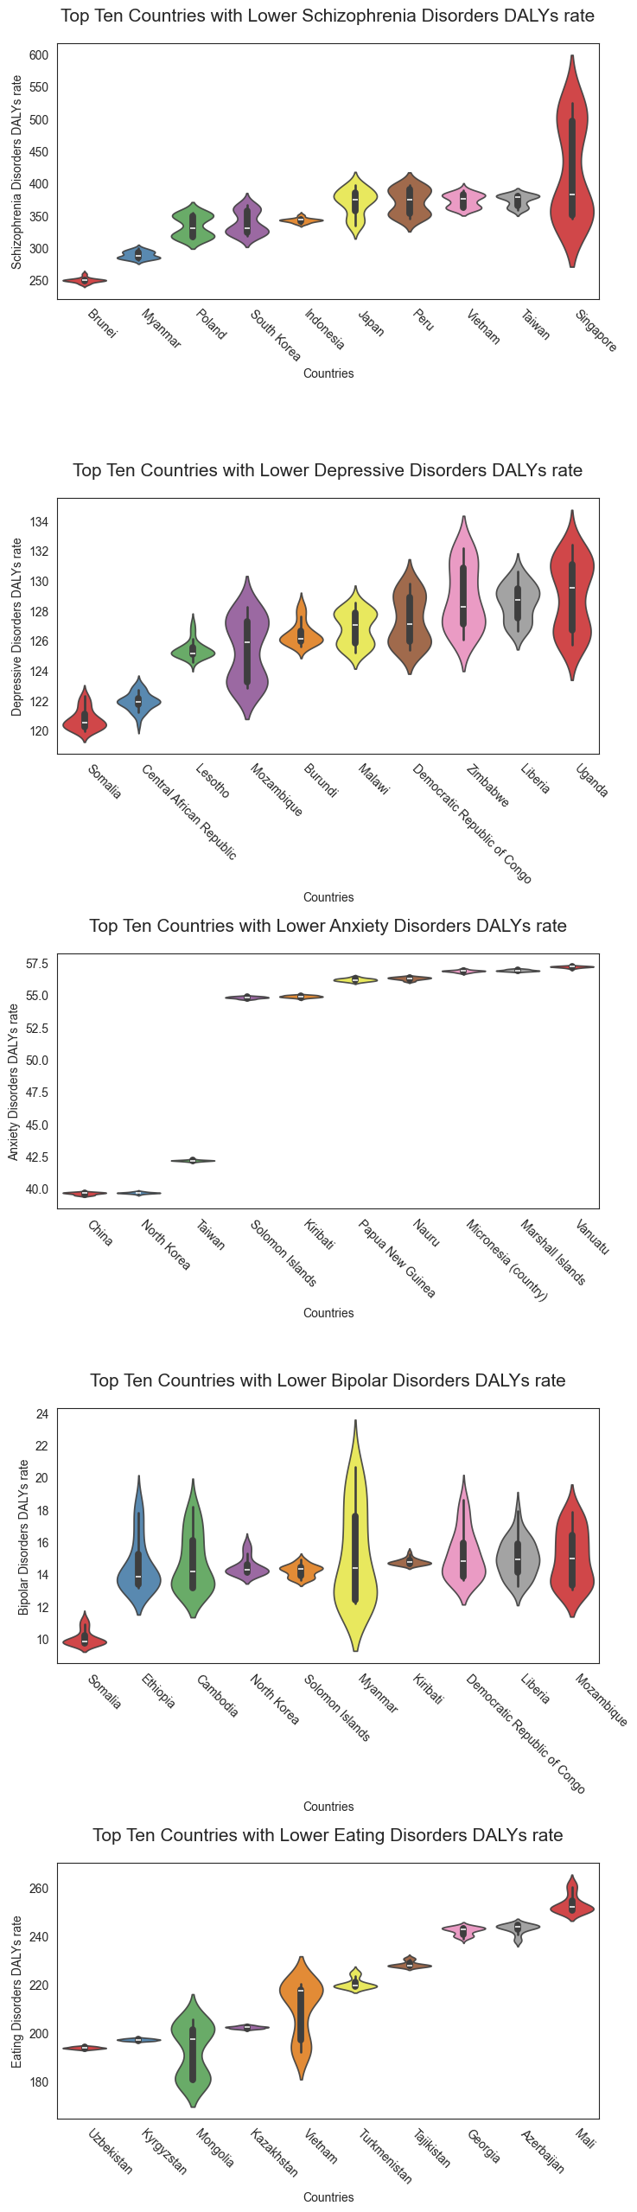
Mental health disorders prevalence and burden analysis by country
All of the p-values < 10^(-20) !

Slide 114

Mental health disorders prevalence and burden analysis by country
↓59-52%

Slide 115
Mental health disorders prevalence and burden analysis by country
↓35-34%

Slide 116
Mental health disorders prevalence and burden analysis by country
↓63-62%

Slide 117
Mental health disorders prevalence and burden analysis by country
↓71-59%

Slide 118
Mental health disorders prevalence and burden analysis by country
↓47%

Slide 119
Mental health disorders prevalence and burden analysis by country

Slide 120
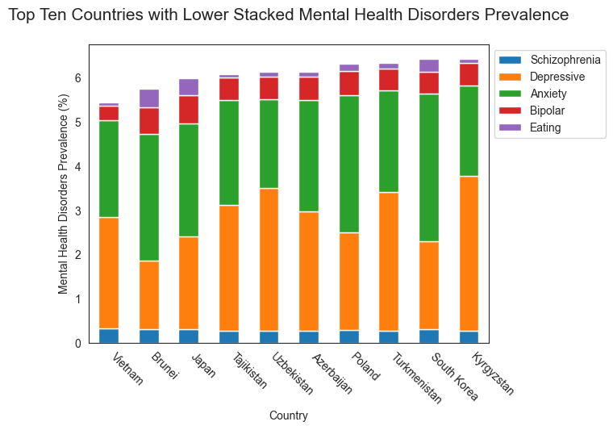
Mental health disorders prevalence and burden analysis by country
↓ 34-22%
All of the p-values < 10^(-40) !

Slide 121
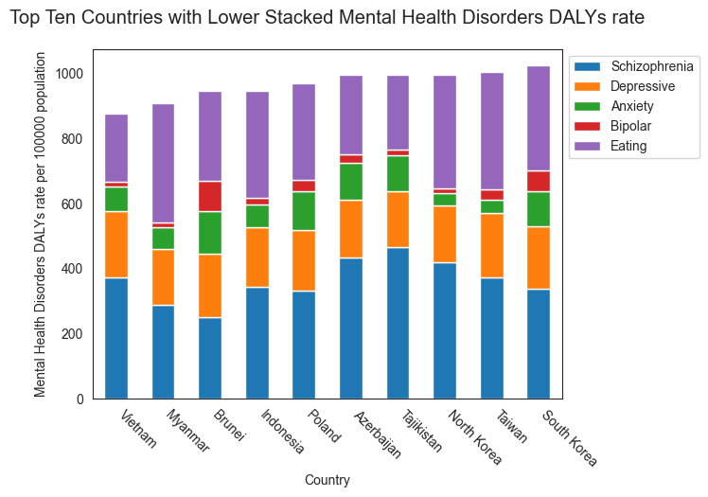
Mental health disorders prevalence and burden analysis by country
↓ 34-22%
↓ 32-20%
All of the p-values < 10^(-40) !

Slide 122
Mental health disorders metrics correlations

Slide 123
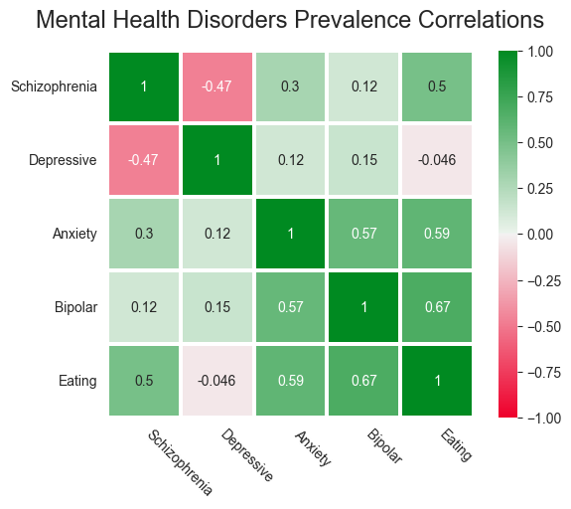
Mental health disorders metrics correlations

Slide 124
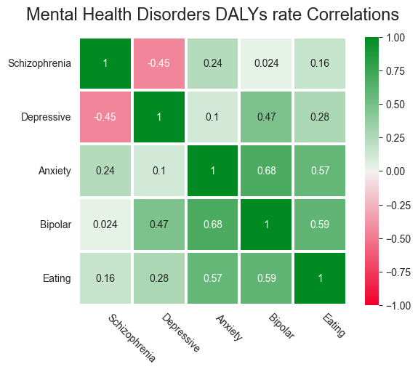
Mental health disorders metrics correlations

Slide 125
Mental health disorders metrics correlations

Slide 126
Mental health disorders metrics correlations

Slide 127
Mental health disorders metrics correlations

Slide 128
Mental health disorders metrics correlations

Slide 129
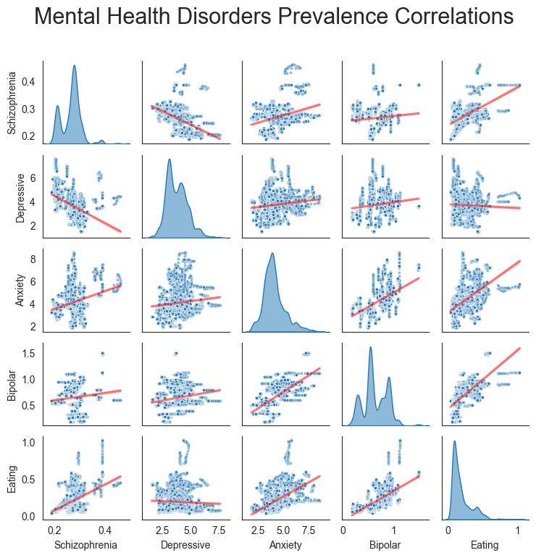
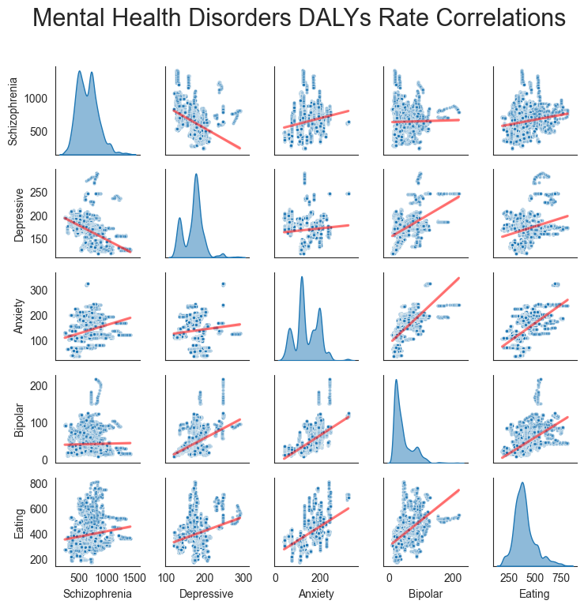
Mental health disorders metrics correlations

Slide 130
Mental health disorders metrics correlations

Slide 131
Mental health disorders choropleth maps

Slide 132
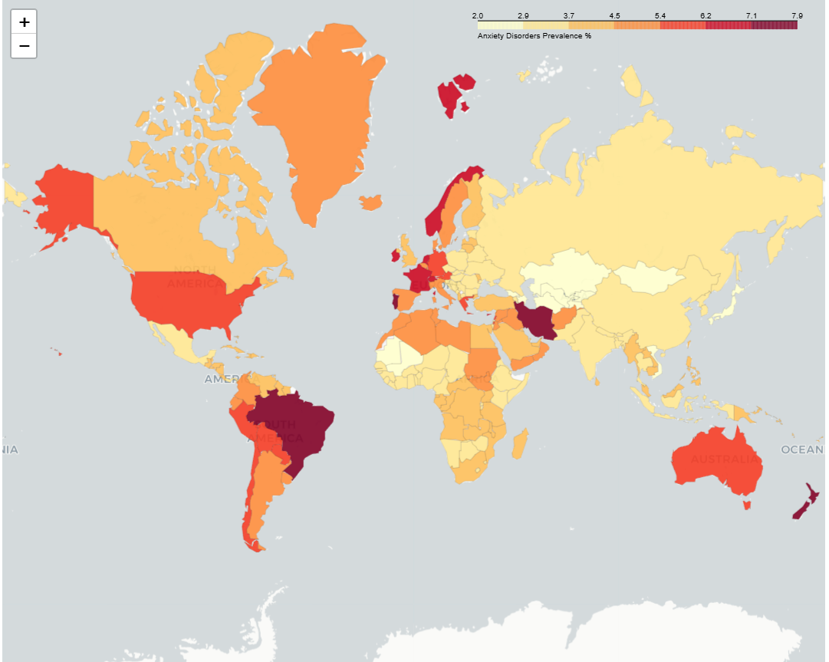
Mental health disorders choropleth maps

Slide 133
Mental health disorders choropleth maps
In order to have an interactive experience with the choropleth maps visit this:
Streamlit Webpage

Slide 134
CONCLUSIONS

Slide 135
CONCLUSIONS
All five major mental health disorders show statistically significant temporal changes in both prevalence and DALYs rates, demonstrating that mental health challenges are dynamic and evolving worldwide.

Slide 136
CONCLUSIONS
All five major mental health disorders show statistically significant temporal changes in both prevalence and DALYs rates, demonstrating that mental health challenges are dynamic and evolving worldwide.
Significant differences between mental health metrics of different countries were found ,witch highlight global disparities in burden, detection, and treatment access

Slide 137
CONCLUSIONS
All five major mental health disorders show statistically significant temporal changes in both prevalence and DALYs rates, demonstrating that mental health challenges are dynamic and evolving worldwide.
Significant differences between mental health metrics of different countries were found ,witch highlight global disparities in burden, detection, and treatment access
Except for schizophrenia, high-income countries consistently display higher prevalence and greater disability burden, indicating that mental health challenges are more visible and impactful in developed contexts. Some low-income regions may underreport or underdiagnose mental disorders, masking true disability.

Slide 138
CONCLUSIONS
All five major mental health disorders show statistically significant temporal changes in both prevalence and DALYs rates, demonstrating that mental health challenges are dynamic and evolving worldwide.
Significant differences between mental health metrics of different countries were found ,witch highlight global disparities in burden, detection, and treatment access
Except for schizophrenia, high-income countries consistently display higher prevalence and greater disability burden, indicating that mental health challenges are more visible and impactful in developed contexts. Some low-income regions may underreport or underdiagnose mental disorders, masking true disability.
Region of the Americas and Europe consistently show the highest prevalence and DALY rates across most disorders, reflecting lifestyle-related stressors, more years lived with disability and greater detection. Africa and South-East Asia/Asia report lower prevalence, but higher DALYs in some disorders (e.g., schizophrenia), suggesting underdiagnosis combined with limited treatment access. Cultural factors, such as societal attitudes toward mental health, stigma, lifestyle norms, and healthcare-seeking behavior, likely modulate both reported prevalence and disability.

Slide 139
CONCLUSIONS

Slide 140
CONCLUSIONS
Schizophrenia: Burden is greatest in low-income countries despite uniform prevalence (~0.2–0.3%), reflecting limited access to sustained care and medication.

Slide 141
CONCLUSIONS
Schizophrenia: Burden is greatest in low-income countries despite uniform prevalence (~0.2–0.3%), reflecting limited access to sustained care and medication.
Anxiety Disorders: Highest in high-income nations (~5% prevalence, DALYs double low-income regions), linked to stress-intensive lifestyles and complete diagnostic coverage.

Slide 142
CONCLUSIONS
Schizophrenia: Burden is greatest in low-income countries despite uniform prevalence (~0.2–0.3%), reflecting limited access to sustained care and medication.
Anxiety Disorders: Highest in high-income nations (~5% prevalence, DALYs double low-income regions), linked to stress-intensive lifestyles and complete diagnostic coverage.
Bipolar Disorder: Stable prevalence, but DALYs rise sharply in wealthier nations (3–4× compared to low-income regions), reflecting chronicity, long-term disability, and detection of milder cases.

Slide 143
CONCLUSIONS
Schizophrenia: Burden is greatest in low-income countries despite uniform prevalence (~0.2–0.3%), reflecting limited access to sustained care and medication.
Anxiety Disorders: Highest in high-income nations (~5% prevalence, DALYs double low-income regions), linked to stress-intensive lifestyles and complete diagnostic coverage.
Bipolar Disorder: Stable prevalence, but DALYs rise sharply in wealthier nations (3–4× compared to low-income regions), reflecting chronicity, long-term disability, and detection of milder cases.
Depressive Disorders: High-income countries lead both in prevalence and DALYs (~4.5–5% prevalence, >210 per 100,000 DALYs), reinforcing depression as a major contributor to global mental health burden.

Slide 144
CONCLUSIONS
Schizophrenia: Burden is greatest in low-income countries despite uniform prevalence (~0.2–0.3%), reflecting limited access to sustained care and medication.
Anxiety Disorders: Highest in high-income nations (~5% prevalence, DALYs double low-income regions), linked to stress-intensive lifestyles and complete diagnostic coverage.
Bipolar Disorder: Stable prevalence, but DALYs rise sharply in wealthier nations (3–4× compared to low-income regions), reflecting chronicity, long-term disability, and detection of milder cases.
Depressive Disorders: High-income countries lead both in prevalence and DALYs (~4.5–5% prevalence, >210 per 100,000 DALYs), reinforcing depression as a major contributor to global mental health burden.
Eating Disorders: Concentrated in high-income nations (~0.4% prevalence, >470 DALYs per 100,000), reflecting cultural pressures, beauty standards, and lifestyle expectations.

Slide 145
CONCLUSIONS
Schizophrenia: Burden is greatest in low-income countries despite uniform prevalence (~0.2–0.3%), reflecting limited access to sustained care and medication.
Anxiety Disorders: Highest in high-income nations (~5% prevalence, DALYs double low-income regions), linked to stress-intensive lifestyles and complete diagnostic coverage.
Bipolar Disorder: Stable prevalence, but DALYs rise sharply in wealthier nations (3–4× compared to low-income regions), reflecting chronicity, long-term disability, and detection of milder cases.
Depressive Disorders: High-income countries lead both in prevalence and DALYs (~4.5–5% prevalence, >210 per 100,000 DALYs), reinforcing depression as a major contributor to global mental health burden.
Eating Disorders: Concentrated in high-income nations (~0.4% prevalence, >470 DALYs per 100,000), reflecting cultural pressures, beauty standards, and lifestyle expectations.
Countries with the highest DALYs rates (e.g., Palestine, Greenland, Australia) show dramatically higher disease burden, reflecting true epidemiological differences or enhanced reporting.

Slide 146
CONCLUSIONS
Schizophrenia: Burden is greatest in low-income countries despite uniform prevalence (~0.2–0.3%), reflecting limited access to sustained care and medication.
Anxiety Disorders: Highest in high-income nations (~5% prevalence, DALYs double low-income regions), linked to stress-intensive lifestyles and complete diagnostic coverage.
Bipolar Disorder: Stable prevalence, but DALYs rise sharply in wealthier nations (3–4× compared to low-income regions), reflecting chronicity, long-term disability, and detection of milder cases.
Depressive Disorders: High-income countries lead both in prevalence and DALYs (~4.5–5% prevalence, >210 per 100,000 DALYs), reinforcing depression as a major contributor to global mental health burden.
Eating Disorders: Concentrated in high-income nations (~0.4% prevalence, >470 DALYs per 100,000), reflecting cultural pressures, beauty standards, and lifestyle expectations.
Countries with the highest DALYs rates (e.g., Palestine, Greenland, Australia) show dramatically higher disease burden, reflecting true epidemiological differences or enhanced reporting.
Countries with lowest DALYs rates (e.g., Vietnam, Myanmar, South Korea) have substantially lower measured burden, likely reflecting underdiagnosis, healthcare limitations, or cultural barriers to detection.

Slide 147
KEY TAKEAWAYS
Mental health burden does not simply decrease with income; high-income contexts may amplify both prevalence and functional impact, especially for anxiety, depression, and eating disorders.
Schizophrenia remains an exception: economic disadvantage correlates with greater disability, underscoring the critical need for global access to psychiatric care.
Geographic and cultural context shapes both detection and disability, highlighting the need for locally tailored interventions alongside universal strategies.
These patterns underscore the importance of targeted, disorder-specific, income- and region-aware public health policies to reduce the global burden of mental disorders.
Global mental health trends are heterogeneous, income-sensitive, geographically influenced, and disorder-specific, requiring strategic, context-aware public health policies to address both rising burdens in high-income nations and treatment gaps in low-income or underdiagnosed regions.

Slide 148




THANKS FOR YOUR ATTENTION
Github Repository
Streamlit Webpage

